Slide 1
Lecture 2
Injecting value into a Bean property

Slide 2
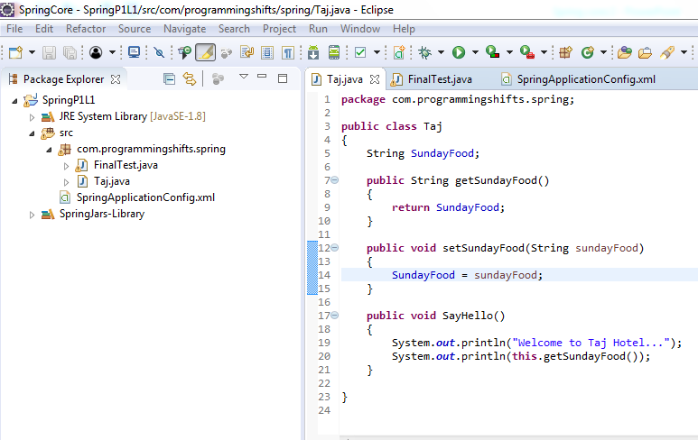

Slide 3
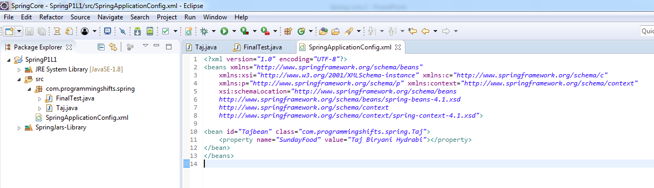
Injecting value into a Bean property

Slide 4
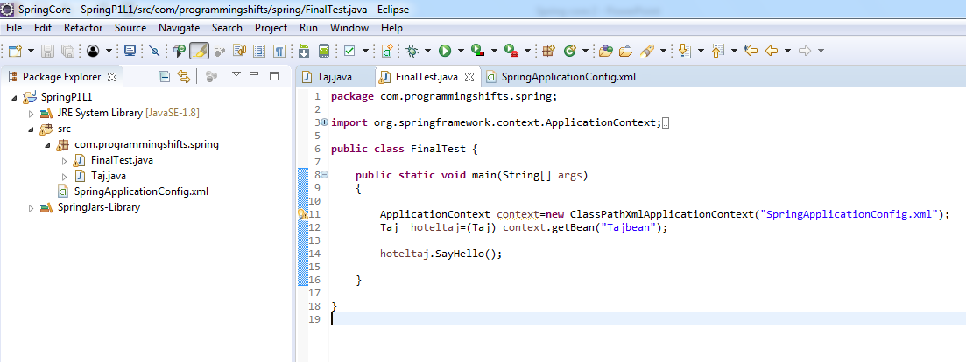
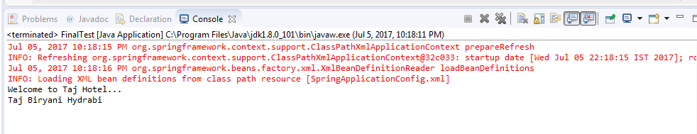
OUTPUT

Slide 5
Thank you ☺ Subscribe Our YouTube Channel # programmingshifts

